Slide 1


Slide 2
What is Tinder?

Slide 3
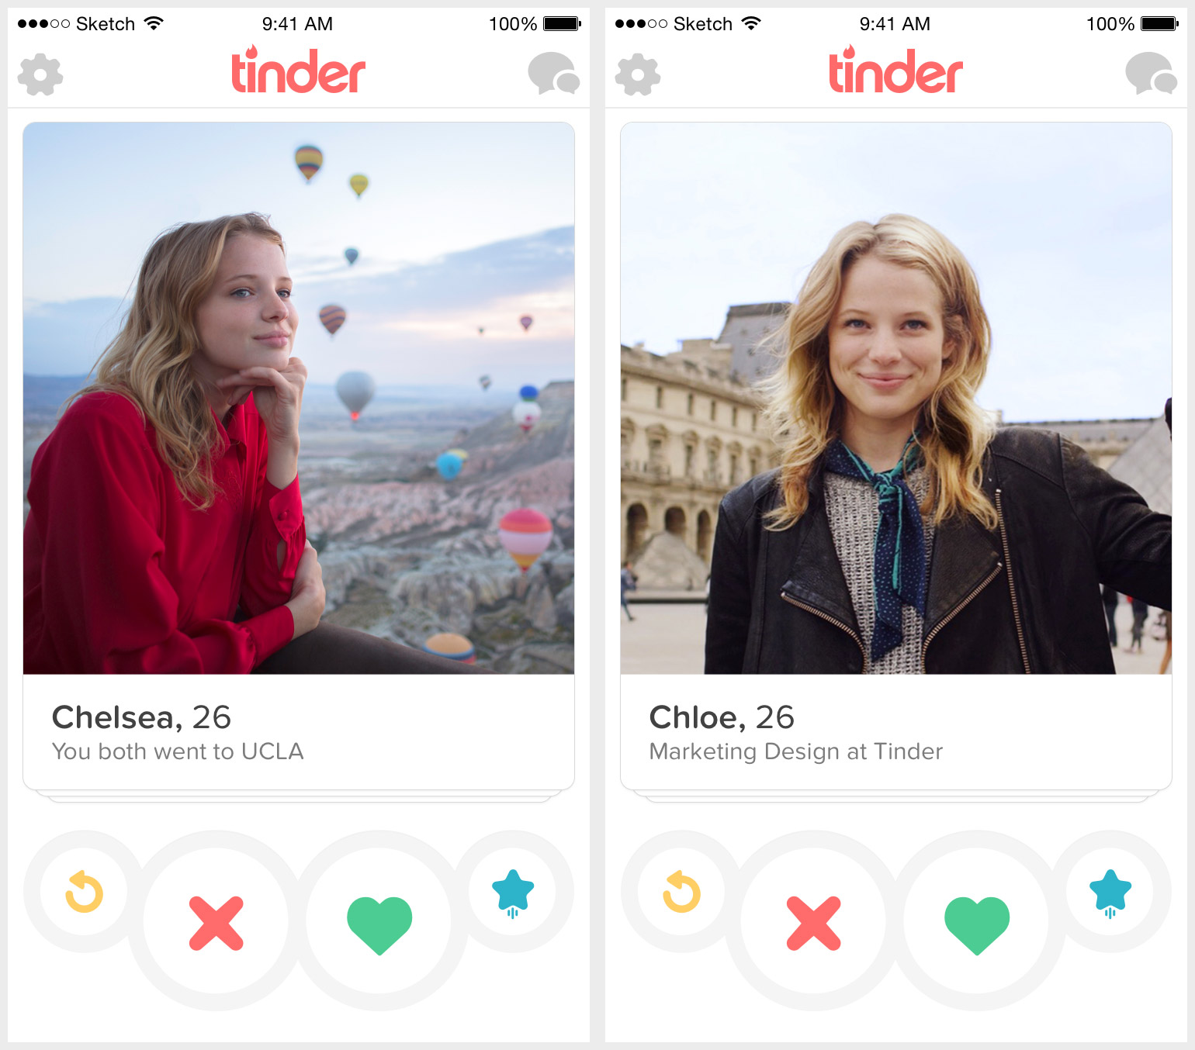

Slide 4


Slide 5
Drawbacks
Buggy
Mobile only
Hides stuff from you (!)

Slide 6
The alternative
A simple web-based interface
That integrates with the official app
And builds new features on top of it

Slide 7
Something like this

Slide 8
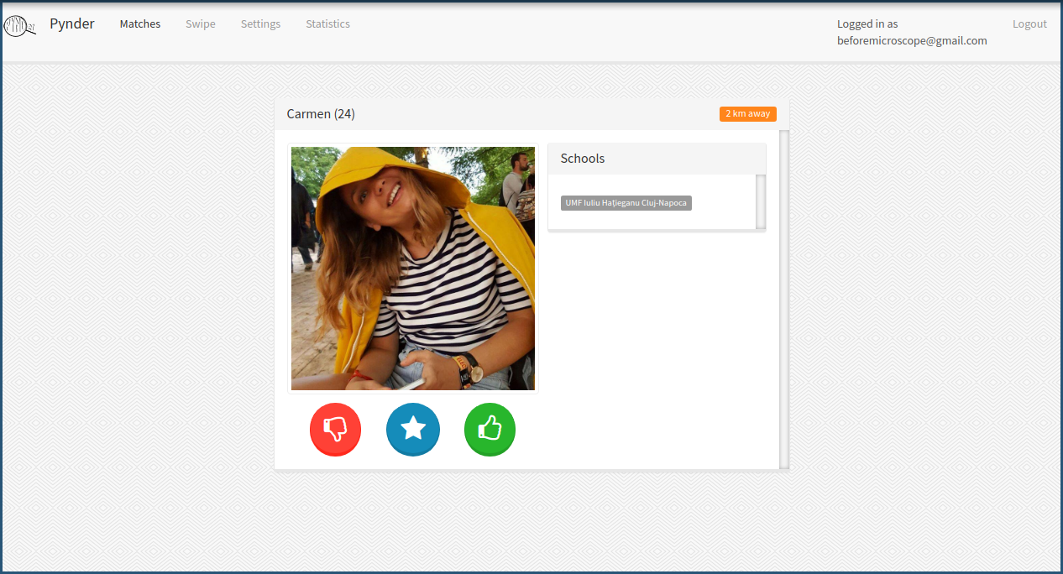

Slide 9
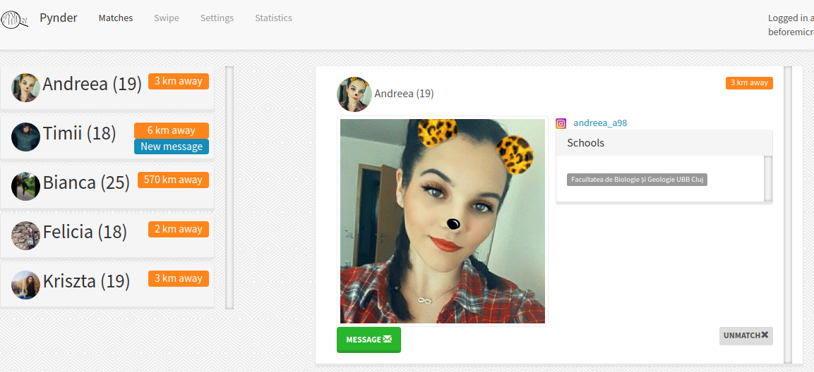
Notable features
Match
browsing

Slide 10
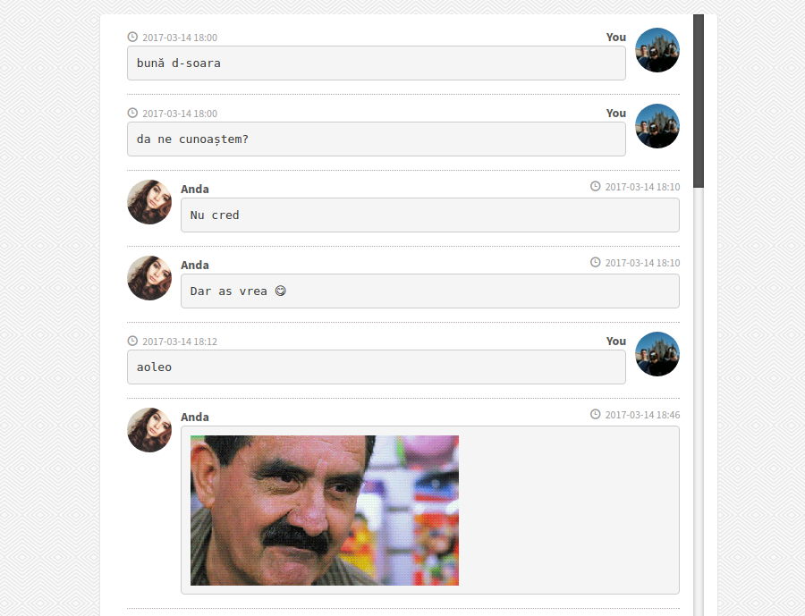
Messaging

Slide 11
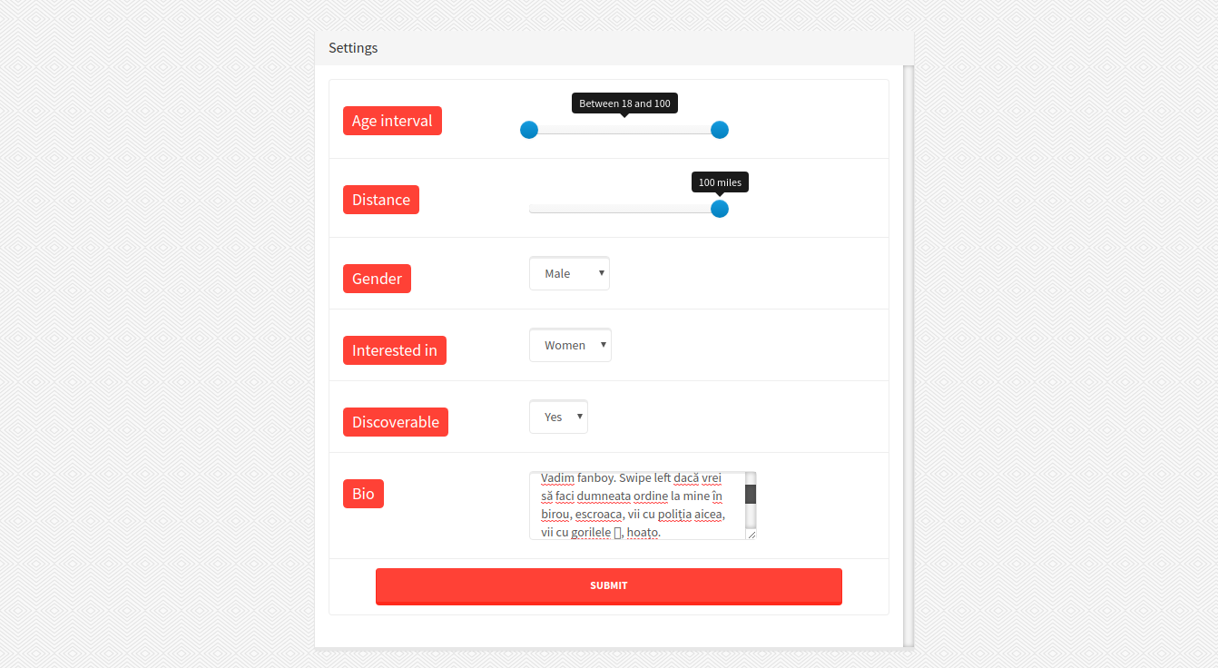
Profile
settings
Messaging

Slide 12
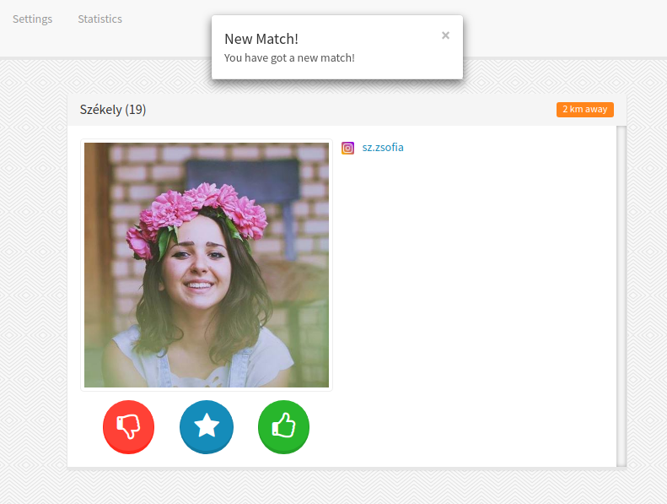
Match
Detection &
Social media integration

Slide 13
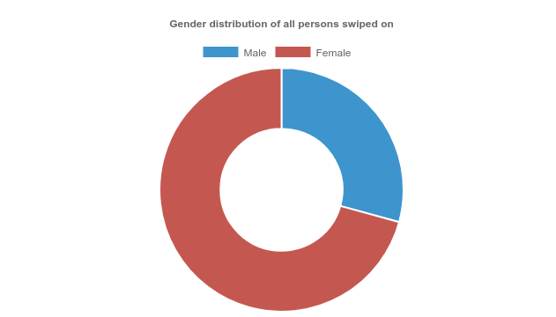
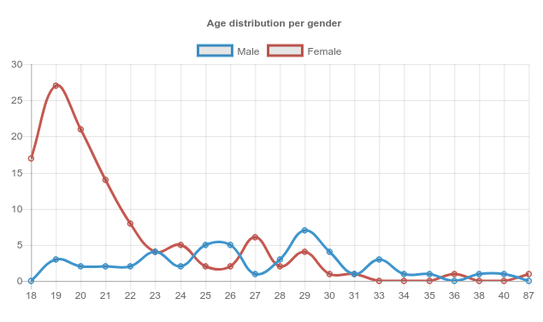
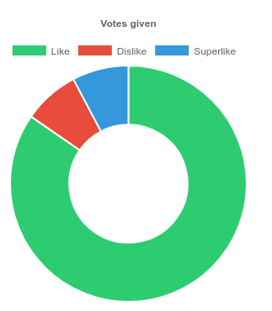
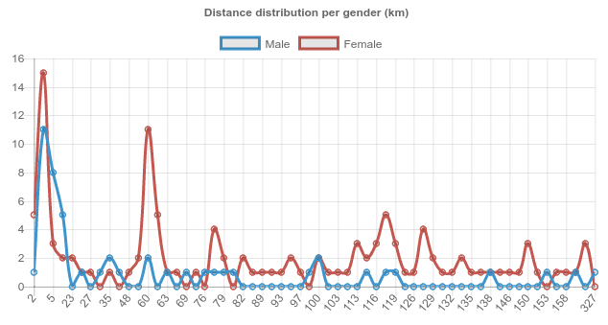
Statistics

Slide 14
Technologies used
Python
Flask (web framework) & Jinja2
SQLAlchemy & PostgreSQL
Git
JavaScript, jQuery, jChart, Ajax
Bootstrap

Slide 15
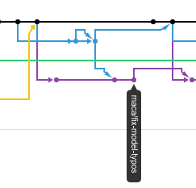
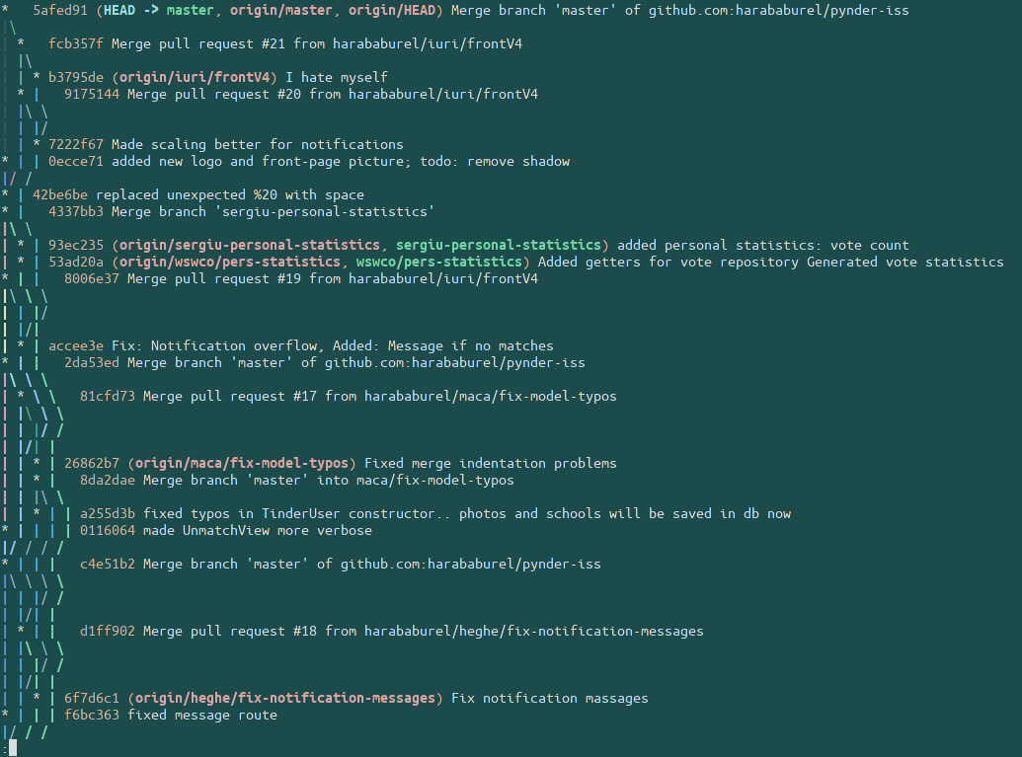
Difficulties
using Git

Slide 16
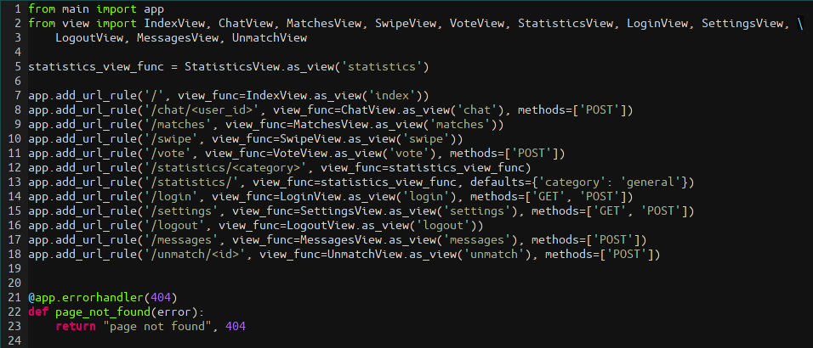
Difficulties
Avoiding spaghetti code as the project grew larger.

Slide 17
Questions?
The project can be found on GitHub.
(https://github.com/harababurel/pynder-iss)

